Slide 1
Marketing Requirements Review (MRR) Business Case for:
Retail High-Bay
Ryan Loggins | 9-11-18
Form: QLP5.29B Rev -

Slide 2
Marketing Requirements Gate Approval Objectives
Marketing Requirements Review (MRR)
Owner: Product Marketing Mgr
Product Requirements Review (PRR)
Owner: Project Mgr
Design Review (DR)
Owner: Project Mgr
Do we move forward with an opportunity and spend money?
Approval to develop a CONCEPT
(up to ~$50K)
Do we move forward to spend money to do product design & testing?
Approval to start formal DEVELOPMENT
(up to ~ $1M)
Do we move forward to spend money to qualify the design solution?
Approval to begin CREE EVAL000
(up to ~ $250K)
Qualification or Design Complete Review (QR or DCR)
Owner: Project Mgr
Market Launch Review (MLR)
Owner: Project Mgr
Do we freeze the design and move forward to spend money to tool the project?
Approval to build hard tools, and complete Manufacturing Readiness (up to ~$750K)
Do we move forward to take orders and ship?
Approval to announce to market and
take orders
Form: QLP5.29D Rev -

Slide 3
MRR Gate Review Agenda
Opportunity Overview
Product Overview
Competitive Landscape
Product Requirements
Financial Requirements
New Product Impacts on Existing Product Lines
Schedule Requirements
Concept Development Team
Action Items

Slide 4
Market Opportunity

Slide 5
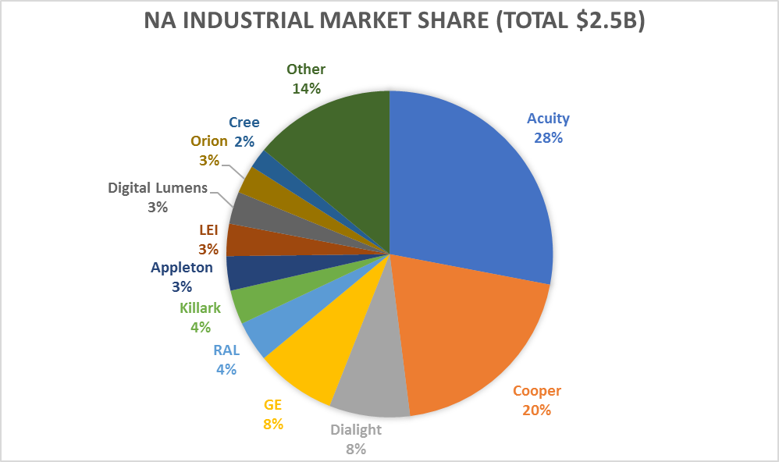
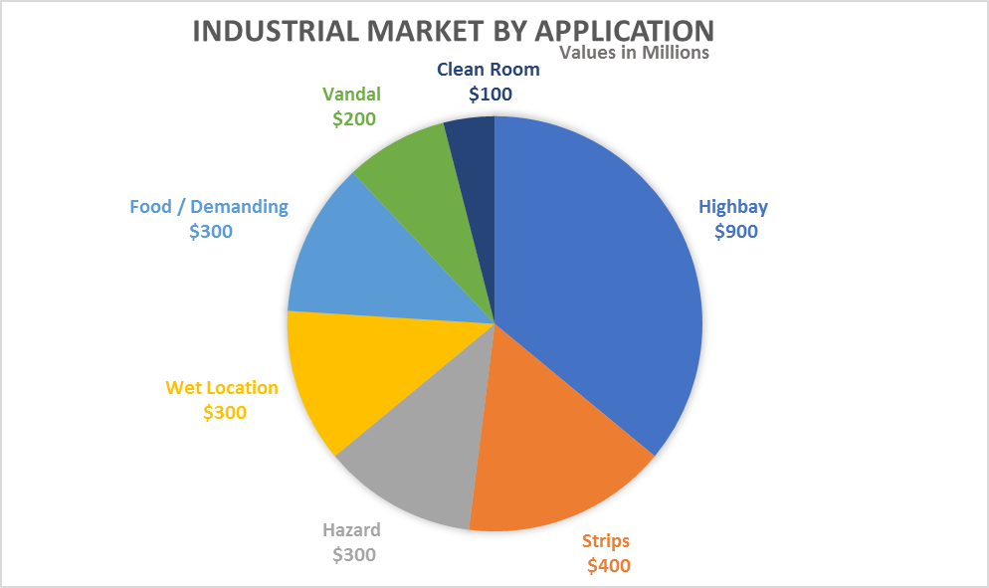
Industrial Market Landscape
The Industrial Market is a huge strategic opportunity for Cree.
It is not as encumbered with a large number of competitors.
Currently not a strategic target for importers due to the commitment to the channel that is required to win.
Top Applications for Cree to focus:
Highbay
Strips
Wet Location
Food / Demanding
Hazard
Sources: Internal Cree Estimates, DOE 2016, Navigant Research 2015

Slide 6
Industrial Market Landscape
The Industrial Market is a huge strategic opportunity for Cree.
It is not as encumbered with a large number of competitor.
Currently not a strategic target for importers due to the commitment to the channel that is required to win.
Estimate lower lumen packages to make up about 15% of installations
Cree’s typical Market share, between 2-4%
Sources: Internal Cree Estimates, DOE 2016, Navigant Research 2015

Slide 7
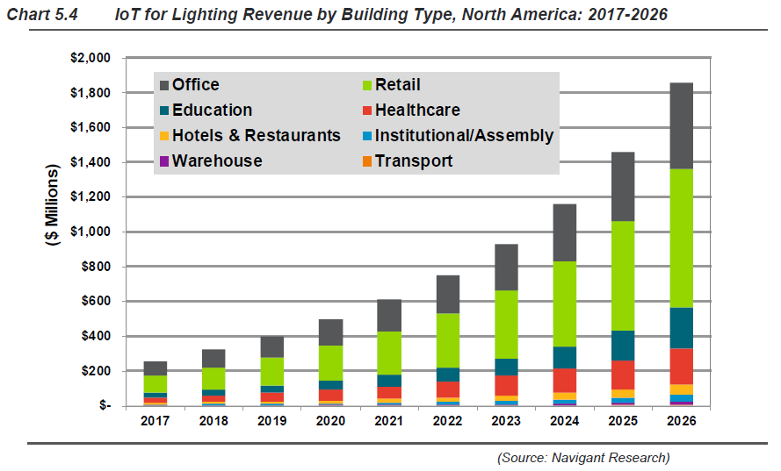
Industrial High-bay Market
$900M High-Bay Market
High-Bay with Controls
Incremental Market with Controls
Fixture with basic wireless radio/occ sensor/photocell
14%
$126M

Slide 8
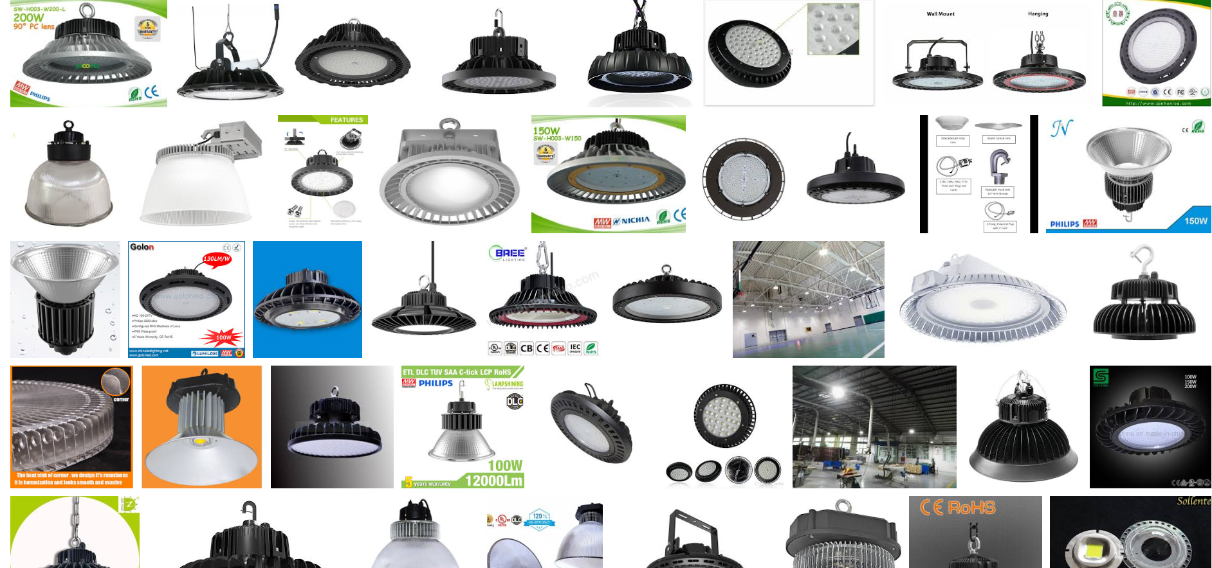
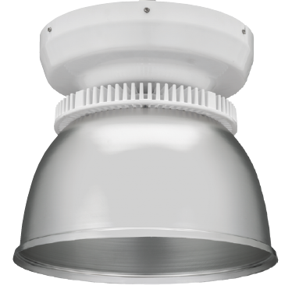
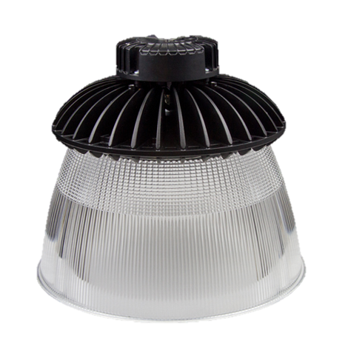
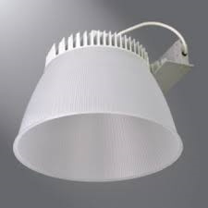
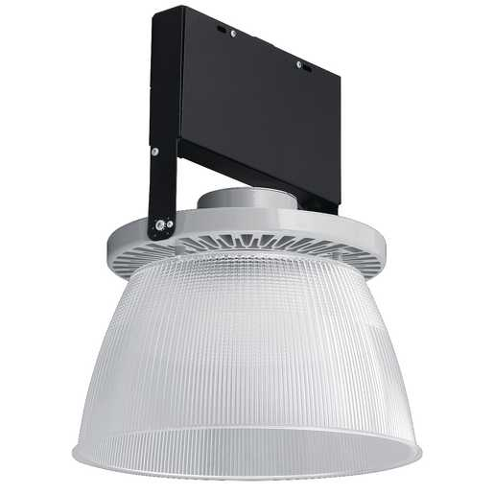
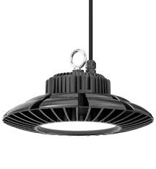
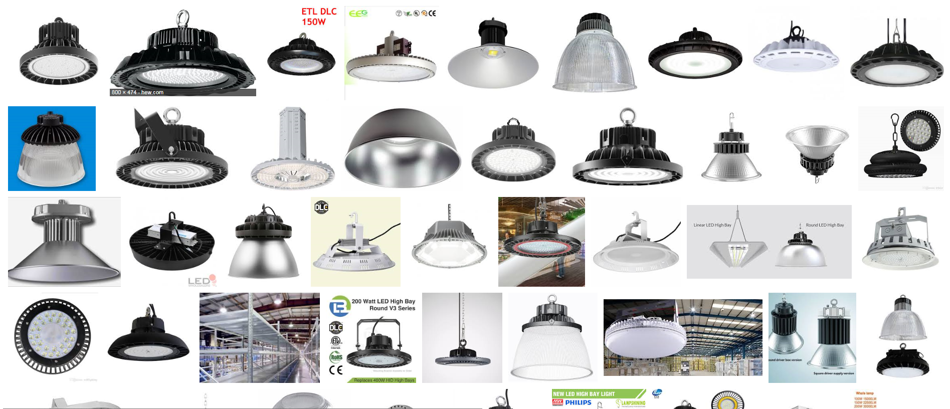
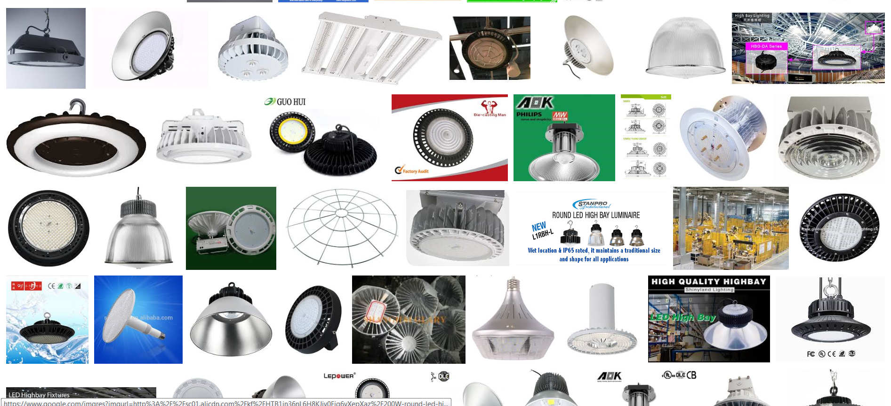
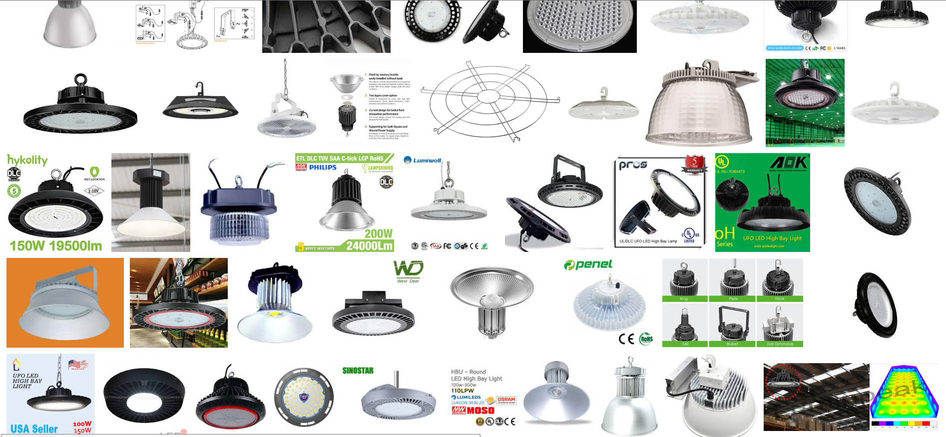
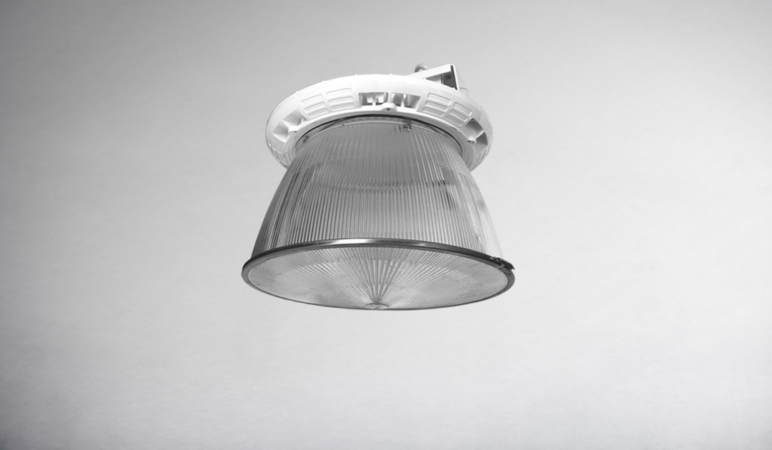
Current State
KBL currently serves as both the retail and light industrial solution. Light engine performance is base- lined at 80CRI for retail customers.
KBL tapped out on capabilities
Market has closed performance gap & become saturated with KBL and UFO style fixtures.
Similar look/Similar performance creates price pressure
Large users are asking for more value!
higher lumen packages, up-light, optical control, center mounted drivers, controls, energy savings, easy to install, serviceability
Costco currently threatening KBL value prop becomes weaker each day
Currently only servicing retrofit business
Not able to meet new construction or Canadian requirements
Trying to reduce fixture counts with wider spacing for years
Center mounted driver is desirable
DSG- Price pressure
Trying to reduce fixture counts with wider spacing
Eliminate shadows caused by high displays
Center mounted driver is desirable
Lost Total Wine as customer-$1.5M
Quality
Price/Value

Slide 9
KBL-Retail vs Non-Retail
Average ASP $294
Retail $263
Non-Retail $301
Total Revenue $24.3M
Retail $12.2M
Non-Retail $12.1M
86,007 Units

Slide 10
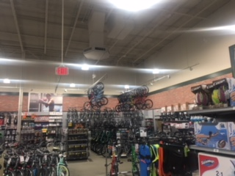
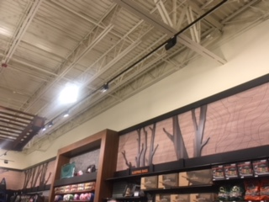
Retail Customer Challenges/Goals
Reduce Total Cost of Ownership
Energy Savings/Rebates
Maintenance
Compliance
Fixture counts
Display merchandise in best possible way
Maintain/Enhance uniformity
Minimize cave effect
Maintain consistent look throughout facility
Maximize vertical/horizonal foot candles
Optimize light levels by zone
Foot ware avg. 100 fc
Checkout 80fc
Turn off strobing fixture
Minimize Contractor Installation Time/Waste
Easy Wiring
Ready to go out of the box
Job Packs
Field Serviceable
Actionable data
Replaceable components
Minimize downtime/ # of trips

Slide 11

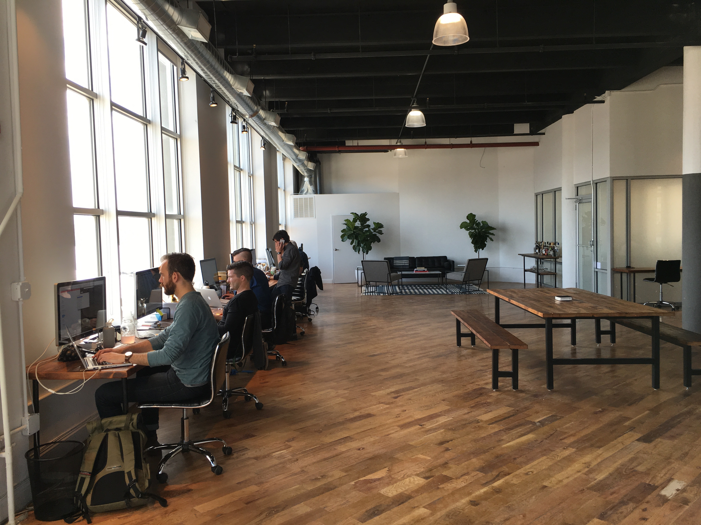
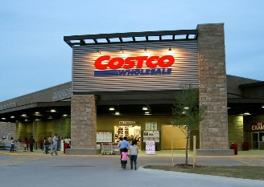
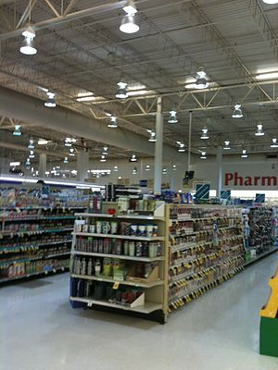

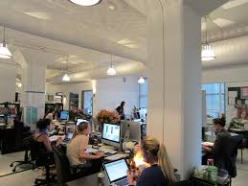
Retail High-Bay
Target Applications: Big Box Retailers, Fitness Gyms, Open Ceiling Retail, Grocery, Commercial Open Loft Space
Target Customers: Dicks Sporting Goods, Harris Teeter, Costco, DSW, Total Wine, Publix, Wal-Mart
Cost
Performance
Reduce overall fixture count
Eliminate perimeter track lighting
Eliminate shadows throughout sales floor
Uniformity
Zonal Control/Daylight
High CRI, Up-light
Make merchandise pop
Consistent Look
Battery Pack
Appearance
Ability to maintain somewhat traditional look
Dramatic change not desired
Center mounted driver is sought after
Proportional size to mounting height
Ease of install
Easy wiring accommodations
Simplicity
Fast
Field Serviceable
Change out drivers, boards, optics in field
Preferably without having to benchtop

Slide 12
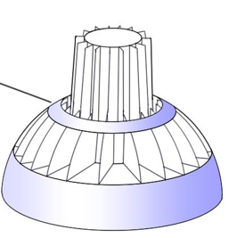

Retail High-Bay- “Shoplifter”
Project type: Innovation
Retail High-Bay is optimized to maximize fixture spacing while delivering best in class optical control. RXB will dramatically reduce fixture counts while enhancing merchandise appeal with 90CRI LEDs- without sacrificing delivered lumens performance. Energy savings and return on investment are enhanced with DLC premium performance coupled with wireless controls.
Project Market Drivers:
Target Market / Customer: Retail
Target Application: Conditioned-Semi Conditioned Space
Sales Channel Focus: National Accounts
Key Product Features:
12L, 18L, 24L, 30L, 35L
Up Light 10-14%
5YR/ Optional 10YR Warranty,
Extra Wide Distribution, High Vertical FCs
Center mounted driver, clean aesthetics
Wireless Controls, Battery Pack
-40C to 40C, 120-277v, 347-480v
Financial Estimates | Sales (000s) | GM%
Year 1 | $9M | 35%
Year 2 | $13M | 35%
Year 3 | $20M | 35%

Slide 13
Retail High-Bay Volume Assumptions
 |  | Program: | Retail High-Bay
 |  |  | First Year | Year 2 (run rate) | Program Avrg |  | Total Program
 |  | Total Revenue | $9,299,250 | $13,791,151 | $0.0 |  | $90,641,133
 |  | ASP | $296.7 | $298.2 | $296.7
 |  | COGS | $192.4 | $193.4 | $192.4 |  | $58,768,026
 |  | Gross Margin | $104.3 | $104.8 | $104.3 |  | $31,873,107
 |  | % | 35.2% | 35.2% | 35.2% |  | 35.2%
 |  | Volume |  |  |  |  |  |  | Sales Price
 |  | Year 1 | Year 2 | Year 3 | Year 4 | Year 5 |  |  | Year 1 | Year 2 | Year 3 | Year 4 | Year 5
12L |  | 1200 | 1660 | 2660 | 3096 | 3468 |  |  | $ 180.0 | $ 180.0 | $ 180.0 | $ 180.0 | $ 180.0
18L |  | 2800 | 3320 | 6080 | 5848 | 6550 |  |  | $ 200.0 | $ 200.0 | $ 200.0 | $ 200.0 | $ 200.0
24L |  | 4000 | 6308 | 9215 | 10148 | 11366 |  |  | $ 225.0 | $ 225.0 | $ 225.0 | $ 225.0 | $ 225.0
30L |  | 800 | 863 | 1235 | 1204 | 1348 |  |  | $ 245.0 | $ 245.0 | $ 245.0 | $ 245.0 | $ 245.0
35L |  | 500 | 581 | 855 | 946 | 1060 |  |  | $ 265.0 | $ 265.0 | $ 265.0 | $ 265.0 | $ 265.0
12L Wireless |  | 300 | 415 | 665 | 774 | 867 |  |  | $ 280.0 | $ 280.0 | $ 280.0 | $ 280.0 | $ 280.0
18L Wireless |  | 700 | 830 | 1520 | 1462 | 1637 |  |  | $ 300.0 | $ 300.0 | $ 300.0 | $ 300.0 | $ 300.0
24L Wireless |  | 15000 | 25232 | 36765 | 40592 | 45463 |  |  | $ 325.0 | $ 325.0 | $ 325.0 | $ 325.0 | $ 325.0
30L Wireless |  | 3200 | 3453 | 4940 | 4816 | 5394 |  |  | $ 345.0 | $ 345.0 | $ 345.0 | $ 345.0 | $ 345.0
35L Wireless |  | 2000 | 2324 | 3420 | 3784 | 4238 |  |  | $ 365.0 | $ 365.0 | $ 365.0 | $ 365.0 | $ 365.0
12L Battery Pack |  | 45 | 62 | 100 | 116 | 130 |  |  | $ 305.0 | $ 305.0 | $ 305.0 | $ 305.0 | $ 305.0
18L Battery Pack |  | 105 | 125 | 228 | 219 | 246 |  |  | $ 325.0 | $ 325.0 | $ 325.0 | $ 325.0 | $ 325.0
24L Battery Pack |  | 570 | 946 | 1639 | 1522 | 1705 |  |  | $ 350.0 | $ 350.0 | $ 350.0 | $ 350.0 | $ 350.0
30L Battery Pack |  | 120 | 129 | 185 | 181 | 202 |  |  | $ 370.0 | $ 370.0 | $ 370.0 | $ 370.0 | $ 370.0
35L Battery Pack |  | 75 | 87 | 128 | 142 | 159 |  |  | $ 390.0 | $ 390.0 | $ 390.0 | $ 390.0 | $ 390.0

Slide 14
Retail High-Bay Volume Assumptions
Retail High-Bay will cannibalize approx. 55,000 units from KBL.. Y1(25%), Y2(65%), Y3(10%)
Updated Optics, Uplight, lumen packages and form factor will open up Costco New construction locations
Secure existing business between DSG, Harris Teeter, Costco,
Appeal to new accounts including DSW, Grocery stores, Open ceiling commercial space
 | Y1 | Y2 | Y3
Existing Retail busines | 15000 | 35750 | 55000
Costco New Const. | 4500 | 6500 | 8500
Incremental, DSW, Total, Open Ceiling | 11480 | 4350 | 5700
Misc Accounts | 11340 | 3500 | 4500
DSG-Approx. 125 stores/ year 150 units/store
Costco-Retrofit- 25 stores/ year 550 units/store Assumes 17 stores
Costco-New Const. 30 stores/year 450 units/store Assumes 4 stores
Harris Teeter- 3500 units/year Assumes 23 stores
Total Wine-3000 units/year assumes 30 stores
****Very conservative on DSG/Costco usage****************

Slide 15
Project Overview
Complete range of lumen packages
High CRI options without delivered lumen penalties
Optical Control to maximize fixture spacing, up to 16’ on center
Optional Up-light between 10-15%
High Vertical Foot candles to eliminate perimeter track/ showcase
Integrated wireless Controls and battery Pack at launch
Easy to Install/Field Serviceable
Standard 5 year warranty. Ability to support 10 year warranty for typical retail hours of operation
Requested launch timing-12 months

Slide 16
Competitive Information

Slide 17
Competitive Landscape
Product gaps compared to market
Competitive Benchmark
Addressed gaps and differentiation
 | Cree | Cree | LSI | Lithonia | Lithonia | Holophane | Lithonia | Holophane
 | RE-HI | KBL | Aureus | JCBL | Upgraded JCBL | PHG | JEBL | PHS
Lumen Packages | 12L, 18L, 24L, 30L, 35L | 12L, 15L,18L,24L | 8L, 14L, 17L, 22L | 9L,12L, 15L,18L, 24L, 30L | 9L,12L, 15L,18L, 24L, 30L,36L | 9L,12L, 15L, 18L, 24L, 30L | 12L, 18L, 24, 30L | 12L, 15L,18L, 24L,30L,35L,40L, 45L
Input Watts | <172W | 189 |  | 190 | 160W | 175 | 184
Delivered LPW | 140+ | 140LPW | 136LPW | 123LPW | 154LPW | 124LPW | 144LPW | 146LPW
CRI | 80, 90CRI No lumen drop on higher CRI | 70, 80CRI | 80CRI | 70,80,90CRI | 70,80,90CRI | 70,80,90CRI | 80CRI | 70,80,90CRI
CCT | 30K,35K,40K,50K | 30K,35K,40K,50K | 30K,35K, 40K,50K | 30K,35K, 40K,50K | 30K,35K, 40K,50K | 30K,35K, 40K,50K | 40K,50K | 30K,35K,40K,50K
Lumen Maintenance | L90>36,000, L70>100K | L90>36,000 | L70 > 100k hrs @ 40°C | L84@60,000hours(55°C) | L84@60K hrs @ 55C | L84@60,000hours(55°C) | L90 > 54,000 hours | L93>60,000
Operating Temp | (-40°C to +40°C) | 18L(-40°C up to 50°C | (-40°C to +40°C) | 24L(-40°C up to 50°C) |  | 24L(-40°C up to 50°C) | -40°F (-40°C) to 131°F (55°C) | (-40 °F (60 °C) up
Reflectors | Enclosed Optic/ Optional Acylic/Poly | Acrylic/Alum/Polycarb | Acrylic, Alum | Acrylic, Poly, Alum. | Acrylic, Poly, Alum. | Glass, Acrylic, Poly | Poly, Alum | Glass
Surge Protection | 6Kv/3kA | 6Kv/3kA | 6Kv/3kA | 6Kv/3kA | 6Kv/3kA | 6Kv/3kA | 6Kv/3kA | 10kA/5kV
Ingress Protection | Damp location | Damp location | Damp Location | Damp Location | Damp Location | Damp Location | IP65 | Damp Location
Optical Assembly IP | IP5X | IP65 | ?? | IP65 | IP65 | IP65 | IP65 | IP6X
Uplight | 12-14% | 5% | 13% | 8% | 8% | 8% | 3% | 14%
DLC Premium | Yes | Yes | Yes | No | Yes | Yes | Yes | Yes
Battery Backup | Yes | One Day | Yes | Yes | Yes | Yes | No | Yes
Wireless Controls | Yes- Synapse | One Day | Yes | Yes | Xpoint, nLight, Nlight Air, On/OFF | Yes | No | Xpoint
Weight | MAX 22lbs | 16lbs | 30lbs | 20lbs | 16lbs | 30lbs | 15lbs | 46lbs
Field Servicable | Yes | No | Yes | Yes | Yes | Yes | Yes | Yes
Standard Warranty | 5 year standard(24/7) Optional 10(18/7) | 10 Year | 5 years | 5 years | 5 Years | 5 years | 5 years | 5 years
DSP including reflector | $225 | $259 | ?? | $240 | ?? | $275 | $185 | ??

Slide 18
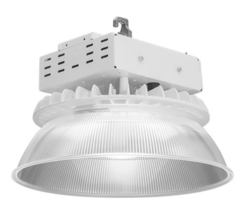
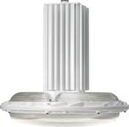
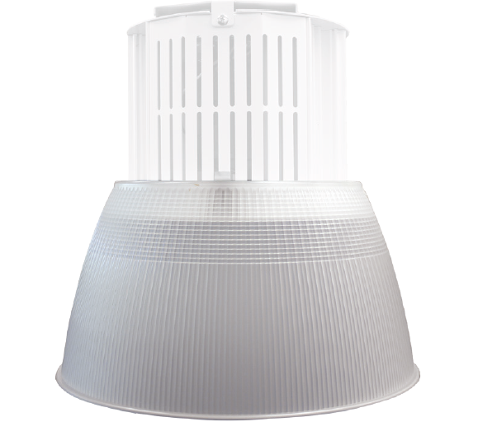
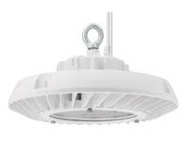
Top Competitors
Holophane PHG
Holophane PHS
Lithonia JEBL
Lithonia JCBL
LSI Aerius
PROS
Center mounted driver
Easy to wire
Uniformity
Uplight ~8% uplight
Wireless Controls
CONS
Square driver box
Sensor version hangs sideways
Low count/pallet
Integral EM adds height
PROS
Center mounted driver
Easy to wire
Uniformity
14% uplight
Wireless Controls
CONS
Weight
$$$$
On task fc due to uplight
Low count/pallet
Remote battery
PROS
Center mounted driver
Easy to wire
Cheap
IP65
CONS
Min. uplight
Heavy foldback
Throw away fixture
No controls/Options
PROS
Center mounted driver
Up to 36,000 lumens
Low Wattage
Controls/Integral EM
CONS
Min Uplight
Uniformity
PROS
Center mounted driver
Controls
12% Uplight
Field Servicable
CONS
Weight
Limited Options
Wattage

Slide 19
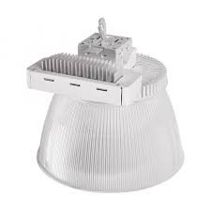
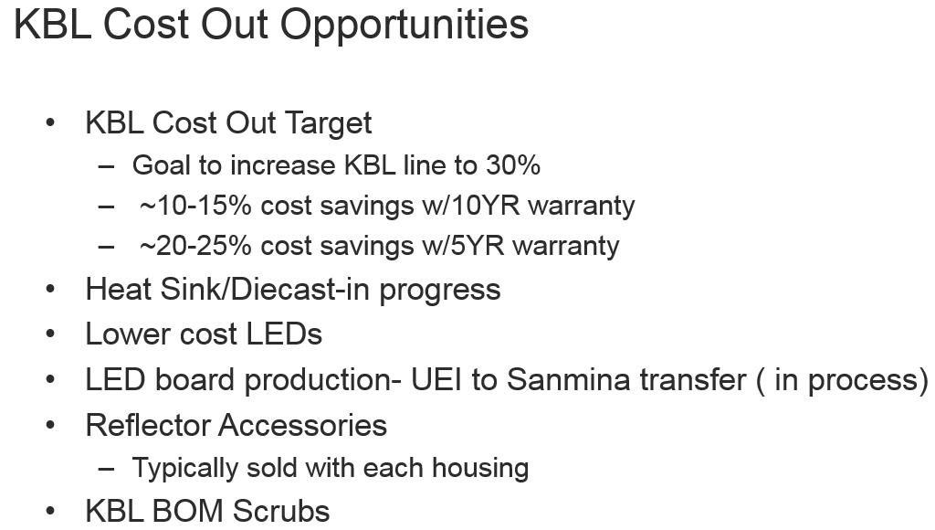
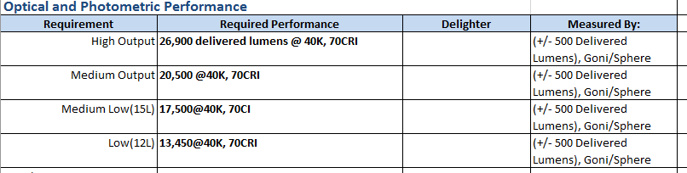
What about KBL?
Re-Baseline performance to 80CRI to 70CRI
LED cost out/change to 3030 or similar at same time
Answer JCBL Upgrade
Launch Retail High-Bay
Focus KBL on Industrial specific applications- warehouse, manufacturing, gymnasiums
LED Cost Down-Re-baseline to 70CRI In process
Test to max ambient without bottom lens/junction box In process
Set Up part numbers for replacement drivers pending
Switch KBL QS inventory to 70CRI Pending Retail High-Bay
KBL Optionality Project-IN PROCESS

Slide 20
Future State Product Positioning

Slide 21

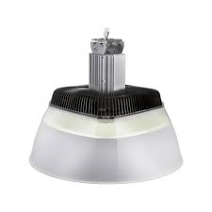

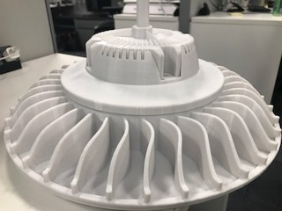
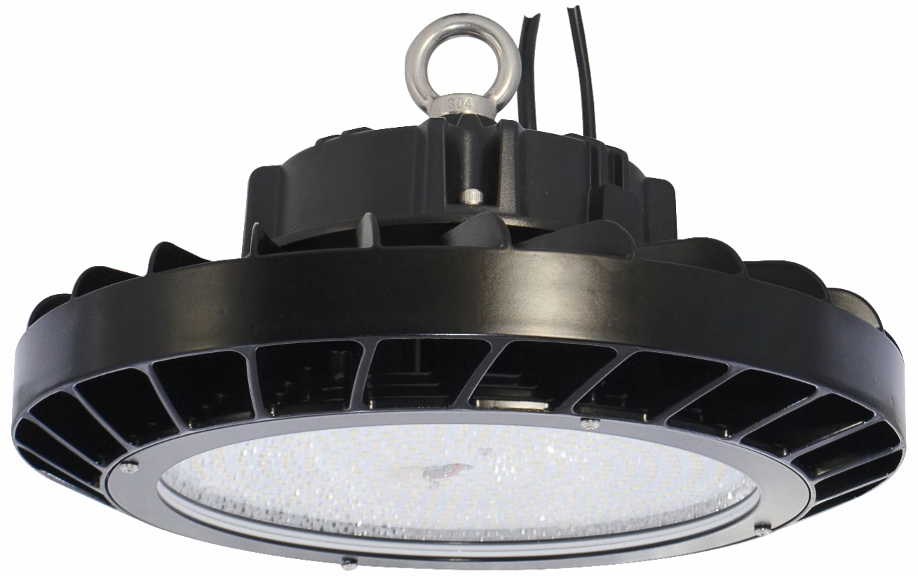
High-Bay Portfolio
12L-35L
40C
12-15% Up-light
Optics
165+ LPW
80-90CRI
5YR(optional 10YR)
$225
12L-30L
50C
130 LPW
70CRI
5 year
$160
12L-24L
50-55C
140+ LPW
70std-80
10 YR
$290
35L-70L
60C
140+ LPW
70-80CRI
$10YR
$1000

Slide 22
Risk of doing nothing
Current retail business will remain at risk, especially at DSG and Costco
Continual pressure to reduce price or provide additional value to maintain business
Costco new construction business will remain out of reach
Potential new customers looking for center mounted driver and “clean” appearance will skip over KBL
KBL will continue to struggle to be the industrial and a retail solution

